Slide 1


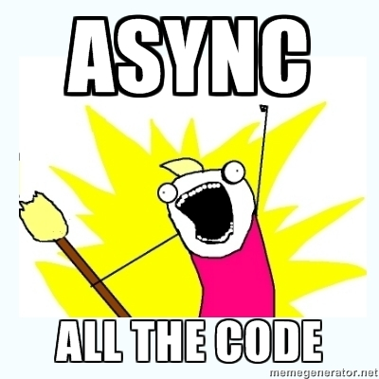

AJAX with ASP.NET MVC
ASP.NET MVC
Telerik Software Academy
http://academy.telerik.com

Slide 2

Table of Contents
What is AJAX?
Raw AJAX vs. using library
Unobtrusive JavaScript
AJAX MVC Helpers
ActionLink
BeginForm
Error handling
Beyond the Built-in Helpers
JSON and MVC

Slide 3
What is AJAX?

Slide 4
AJAX
AJAX is acronym of Asynchronous JavaScript and XML
Technique for asynchronously (in the background) loading of dynamic content and data from the server side
Allows dynamic client-side changes
Two styles of AJAX
Partial page rendering – loading of HTML fragment and showing it in a <div>
JSON service – loading JSON object and client-side processing it with JavaScript / jQuery

Slide 5
AJAX Pros and Cons
Advantages
Asynchronous calls
Minimal data transfer (traffic)
Limited processing on the server
Responsiveness
Disadvantages
The back and refresh button are useless

Slide 6
The XMLHttpRequest object
Raw AJAX
Used to send HTTP or HTTPS requests directly to a web server
The data might be received from the server as JSON, XML, HTML, or as plain text.
Requests will only succeed if they are made to the same server that served the original web page

Slide 7
Demo: Raw AJAX
Raw AJAX Example
function getServerTime() {
var xhr = new XMLHttpRequest();
xhr.open("GET", "/Home/ServerTime", true);
xhr.onreadystatechange = function() {
if(xhr.readyState == 4) {
if(xhr.status == "200") {
var timeDiv=
document.getElementById("timeDisplay");
timeDiv.innerHTML= xhr.responseText;
}
}
}
xhr.send();
}

Slide 8
Demo: AJAX with jQuery
AJAX with jQuery example:
You can use also jQuery functions like:
.ajax()
.get()
.post()
<div id="timeDisplay"></div>
<a onclick="getServerTime()">Get server time</a>
<script>
function getServerTime() {
$("#timeDisplay").load("/Home/ServerTime");
}
</script>

Slide 9

Unobtrusive JavaScript

Slide 10
Unobtrusive JavaScript
No script injected into page
Only data-attributes with necessary AJAX settings
Requires unobtrusive extensions script
jquery.unobtrusive-ajax.js (AJAX helpers)
<a data-ajax="true"
data-ajax-method="GET"
data-ajax-mode="replace"
data-ajax-update="#timeDisplay"
href="/Home/ServerTime">
Get server time
</a>

Slide 11

AJAX Helpers in ASP.NET MVC

Slide 12
AJAX Helpers in ASP.NET MVC
AJAX helpers essentially provides AJAX functionality to ASP.NET MVC applications
Two core features of AJAX helpers:
Invoke an action method using AJAX
Use the Ajax.ActionLink() helper
Submit an entire form using AJAX
Use the Ajax.BeginForm() helper
When calling AJAX helpers you provide AjaxOptions object with configurations

Slide 13
AjaxOptions Object
Url – URL to send request
HttpMethod – Request method (GET or POST)
InsertionMode – What to do with received data
InsertAfter, InsertBefore or Replace
UpdateTargetId – Element to be populated
LoadingElementId – Show/hide when loading
Confirm – Confirmation message
Events (JavaScript functions)
OnSuccess, OnFailure, OnBegin, OnComplete

Slide 14
Demo: Ajax.ActionLink Helper
Defines an action link for getting data
Makes an AJAX request
Can be configured with AjaxOptions
@Ajax.ActionLink("Get server time", "ServerTime", null,
new AjaxOptions {
UpdateTargetId = "timeDisplay",
LoadingElementId = "timeDisplayLoading",
HttpMethod = "GET",
InsertionMode = InsertionMode.Replace,
OnBegin = "OnAjaxRequestBegin",
OnFailure = "OnAjaxRequestFailure",
OnSuccess = "OnAjaxRequestSuccess",
OnComplete = "OnAjaxRequestComplete"
}, new { @class = "btn btn-primary" })

Slide 15
Demo: Ajax.BeginForm Helper
Defines an form for sending data
Makes an AJAX request
Can be configured with AjaxOptions
@using (Ajax.BeginForm("Search",
new AjaxOptions {
UpdateTargetId = "results",
InsertionMode = InsertionMode.Replace
}))
{
<input type="text" name="query" />
<input type="submit" />
}
<div id="results"></div>

Slide 16
Demo: AJAX with PartialView
Return a PartialView to the helpers
Can be done through the original action
public ActionResult BookDetails(int? id)
{
if (Request.IsAjaxRequest())
{
var currentBook = …
return PartialView("_BookDetail", currentBook);
}
var model = …
return View(model);
}

Slide 17
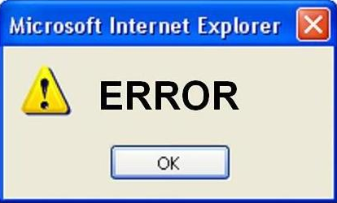
Error Handling

Slide 18
Demo: Error Handling
Default behavior is to fail silently
Override default by specifying OnFailure
Or handle error server side
public ActionResult Search(string query)
{
var result = …
if (result == null)
{
return Content("No results found");
}
return PartialView("_BookDetail", result);
}

Slide 19

Beyond the Helpers

Slide 20
Beyond the Helpers
Ajax Helpers cover simple scenarios
Replacing HTML content
Partial page rendering
Other scenarios require some JavaScript coding
Auto-complete textboxes
Client-side validation
Invoking JSON services and actions
Animations

Slide 21

JSON and MVC

Slide 22
JSON And MVC
Ajax Helpers cover simple scenarios
Replacing HTML content
Partial page rendering
Other scenarios require some JavaScript
Auto-complete textboxes
Client-side validation
Invoking JSON services and actions
Animations

Slide 23
Demo: JSON and MVC
Return JsonResult in the action
Use getJSON method from jQuery
public JsonResult Details()
{
var names = …
return Json(names);
}
$.getJSON("/Cars/Details", "", function(data) {
$(data).each(function() {
…
});
});

Slide 24
AJAX with ASP.NET MVC
http://academy.telerik.com

Slide 25
Homework
Create a database for storing information about Movies – Title, Director, Year, Leading Male Role, Leading Female Role and their Age, Studio, Studio Address.
Create Controllers and Actions for performing CRUD operations over the database.
Create an application that visualize and do operations with your data via Ajax.

Slide 26




Free Trainings @ Telerik Academy
“C# Programming @ Telerik Academy
csharpfundamentals.telerik.com
Telerik Software Academy
academy.telerik.com
Telerik Academy @ Facebook
facebook.com/TelerikAcademy
Telerik Software Academy Forums
forums.academy.telerik.com

